Slide 1
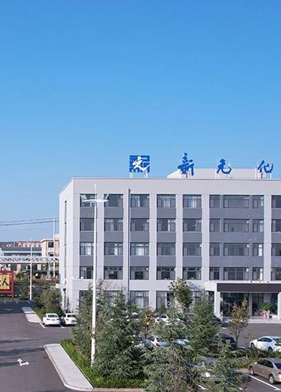

NEWERA
Application Technology Report
On Fluorosilicone Materials
Presenter: Hou Zhiwei

Slide 2
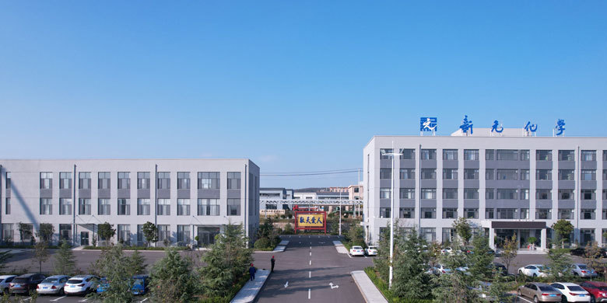
CONTENT
01
Company Profile
02
Overview of Fluorosilicone Materials
03
Fluorosilicone Materials Family
04
Key Applications

Slide 3
ONE
01
Company Profile

Slide 4
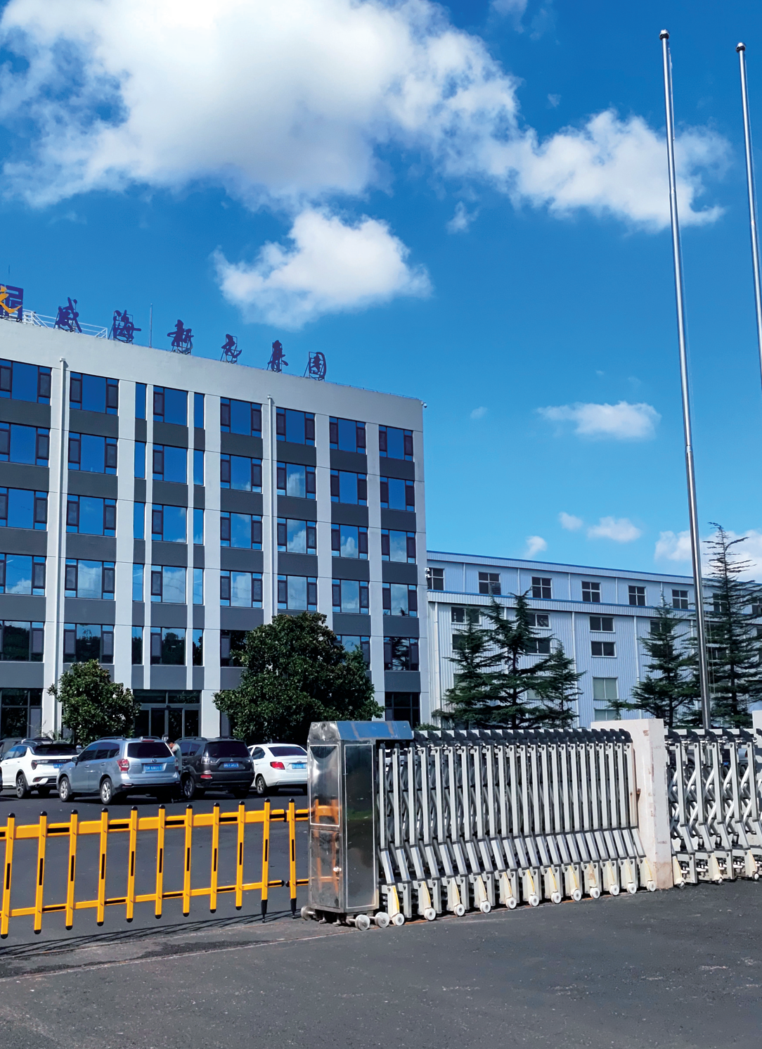
01
Company introduction
New Era Chemical Shandong Co., Ltd., located in Weihai City, Shandong Province, China, is a professional manufacturer of organic fluorosilicone fine chemicals and fluorosilicone materials. The company has established a complete industrial chain spanning from “Tetrachloroethylene → Trifluoropropene → D₃F → Fluorosilicone Rubber and Fluorosilicone Oil.” It is recognized as a National-Level “Specialized, Refined, Distinctive, and Innovative” Small and Medium-sized Enterprise.

Slide 5
TWO
02
Overview of Fluorosilicone Materials

Slide 6

The genetic code of
fluorosilicone materials
Fluorosilicone materials are fluoropolysiloxanes characterized by a siloxane (Si–O) backbone and side chains containing both trifluoropropyl and methyl groups.
They integrate the key strengths of their parent materials: the exceptional heat resistance, low‑temperature flexibility, weathering stability, and electrical insulation of silicones, together with the superior resistance to hydrocarbons, oils, and chemicals, combined with low surface energy, inherent to fluorinated compounds.

Slide 7

Fluorosilicone Materials: Multi-dimensional Performance
Multifunctional chemical resistance
High-temperature resistance
Including fuels, lubricating oils, hydraulic fluids, solvents, and chemicals.
225 ℃
( 250 °C peak )
Outstanding durability
Safe, Eco-friendly
low temperature resistance
Non-toxic, and Odorless.
Excellent resistance to weather, ozone, and aging
( Brittleness Temperature
-62 ℃ )

Slide 8
THREE
03
Fluorosilicone Materials Family

Slide 9
Fluorosilicone oil and fluorosilicone rubber are synthesized via polymerization of D₃F cyclic trimer.
Methyl
Fluorosilicone Oil
Hydroxyl
Fluorosilicone Oil
Vinyl
Fluorosilicone Oil
Si‑H Functional Fluorosilicone Oil
Fluorosilicone Oil
D₃F
Fluorosilicone Rubber
High-Temperature Vulcanized
Fluorosilicone Rubber
Liquid
Fluorosilicone Rubber
2025年

Slide 10
Fluorosilicone Oil
Hydroxy Fluorosilicone Oil
Methyl Fluorosilicone Oil
Characteristics：Hydroxyl-terminated fluorosiloxane polymer
Applications： Used as the structuring control agent for fluorosilicone rubber, and as the base gum or diluent for condensation‑cure, room temperature vulcanizing (RTV) fluorosilicone rubber.
Characteristics：Methyl-terminated fluorosiloxane polymer
Applications： Used as a defoamer, lubricant, and high‑voltage cable insulating fluid; also functions as a release agent, barrier coating agent, and gloss enhancer.

Slide 11
Fluorosilicone Oil
Vinyl Fluorosilicone Oil
Si‑H Functional Fluorosilicone Oil
Characteristics: Vinyl‑terminated fluorosiloxane
Applications：Base gum for addition-cure fluorosilicone rubber
Characteristics： Si‑H (silane‑hydride) terminated fluorosiloxane polymer.
Applications： Functions as a crosslinker for addition‑cure fluorosilicone rubber and as a water‑repellent agent for substrates like rubber and metal.

Slide 12
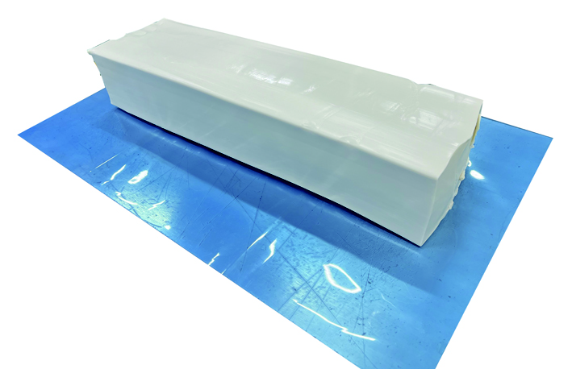
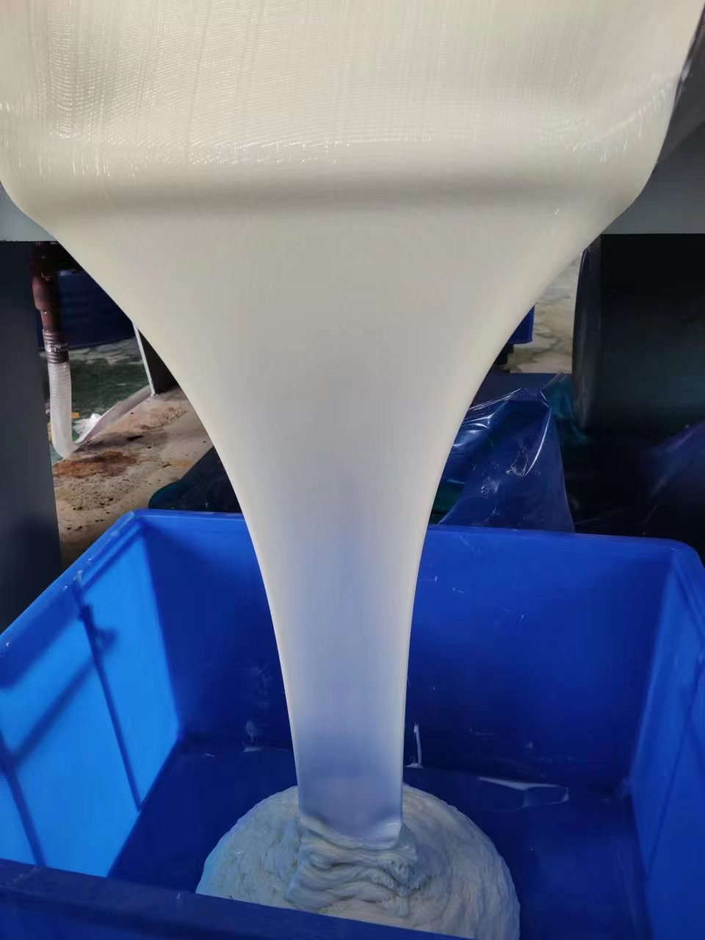
Fluorosilicone Rubber
A hybrid material combining silicone rubber and fluoroelastomer
High-Temperature Vulcanized Fluorosilicone Rubber
A solid compound formulated with a fluorosilicone elastomer gum base, reinforced with silica and modified by structuring control agents and other additives.
01
Liquid Fluorosilicone Rubber
A liquid, addition-curable polymeric material composed of vinyl-functionalized polyfluorosiloxane as the base polymer and hydrosilyl-terminated oligomeric fluorosiloxane as the crosslinker.
02

Slide 13
VS
High-Temperature Vulcanized Fluorosilicone Rubber
Liquid Addition-Cure
Fluorosilicone Rubber
Solid Compound | Basic Form | Liquid, Two‑Part A/B System
Compression molding, Calendering, Extrusion | Processing Method | Injection Moulding
Peroxide Curing | Curing Mechanism | Platinum-Catalyzed Addition Curing
Low | Product Complexity & Precision | Extra-high
Can be produced on a plate vulcanizer; simple mold structure, low cost. | Mold & Equipment Cost | Requires a dedicated LSR injection molding machine; high‑precision molds, high cost.

Slide 14
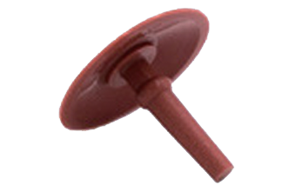
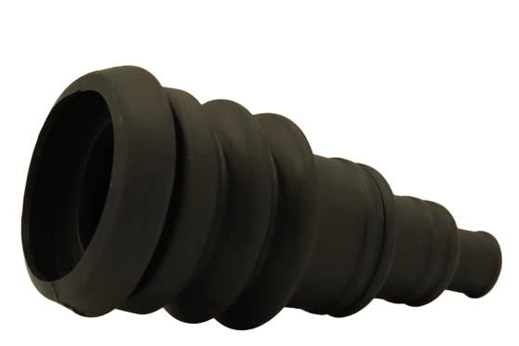
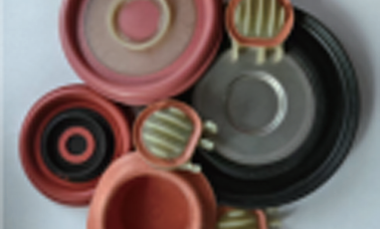
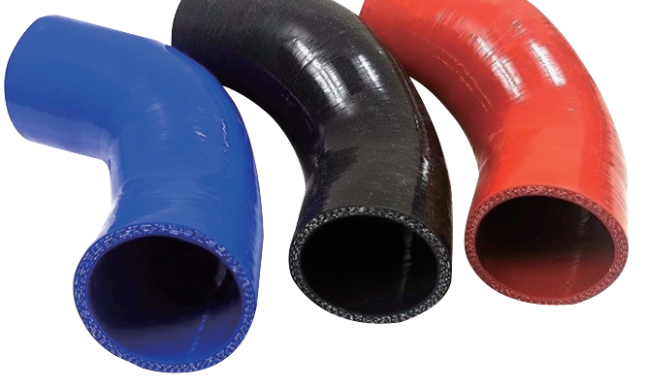
HTV Fluorosilicone Compound Segmentation
01
02
03
04
High-Resilience
Fluorosilicone Rubber
High-Tear-Strength
Fluorosilicone Rubber
Metal‑ / Nylon‑Bondable
Fluorosilicone Rubber
Turbocharger‑Hose‑Grade Fluorosilicone Rubber
Resilience >35%, Suitable for manufacturing umbrella valves, duckbill valves, O‑rings, diaphragms, and similar components.
Offers excellent tensile and tear strength, making it ideal for damping elements and dynamic, fatigue‑resistant parts.
When used with a dedicated primer, it achieves excellent adhesion to metals, nylon, and other substrates.
Features excellent bondability to silicone rubber, enabling the production of turbocharger hoses and other composite hose assemblies.

Slide 15
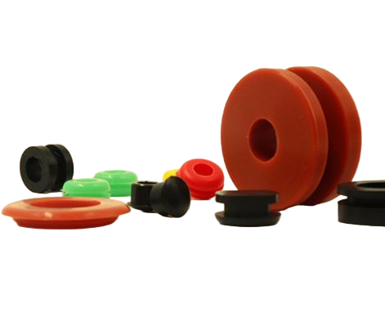
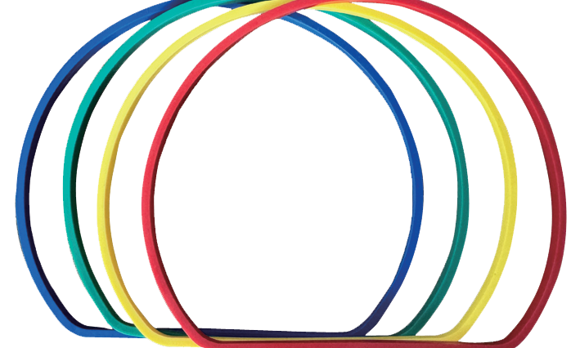
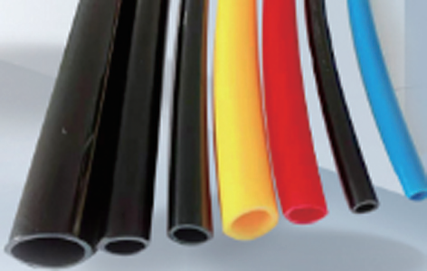
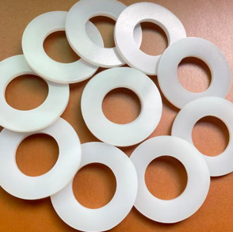
HTV Fluorosilicone Compound Segmentation
05
07
Flame-Retardant Series
Fluorosilicone Rubber
06
Extruded Series
Fluorosilicone Rubber
08
Transformer-specific
Fluorosilicone Rubber
Addition-type
Fluorosilicone Rubber
Excellent flame‑retardant properties, achieving a UL94 V‑0 rating.
Features exceptional resistance to transformer oil with a dielectric loss < 0.5%.
Excellent extrusion processability for manufacturing a wide range of hoses.
Possesses a high safety profile and is suitable for food‑contact applications.

Slide 16
Fluorosilicone Rubber: Heat Resistance
Without Heat-Resistant Stabilizer
With Heat-Resistant Stabilizer
Change in tensile strength
Fluorosilicone rubber is rated for continuous service at 200 °C. Above this temperature, thermal cleavage of the siloxane backbone occurs, degrading mechanical properties. Formulation with heat‑resistant stabilizers is necessary to improve its thermal‑oxidative stability.
Test Condition
Effect of Heat-Resistant Stabilizers on Fluorosilicone Rubber

Slide 17
Fluorosilicone Rubber Curing Systems
The curing systems for fluorosilicone rubber include peroxides (DBPH, DCBP) and platinum‑catalyzed addition cure. Each offers distinct properties for different application needs.
DBPH
Platinum‑Catalyzed
Used for compression/injection molding at 160—170 °C. A cost‑effective solution for general industrial parts, automotive seals, and O‑rings in price‑sensitive applications.
It offers a wide curing temperature range (both high and low). Suitable for applications demanding extreme purity, such as medical, food‑contact, high‑end electronics, and high‑clarity products.
02
01
03
DCBP
Curing temperature range: 100—120 °C. Applied in processes such as hand‑lay‑up coating and extruded rubber hose manufacturing.

Slide 18
Comparison of Fluorosilicone Rubber Processes
Process Type | Compression Molding | Injection Molding | Extrusion Molding | Coating / Cladding
Product Shape | Medium Complexity | High complexity | 2D Constant cross-section | Complex Substrate Surface
Dimensional Accuracy | Good | Excellent | Fair | Process‑ Dependent
Production Efficiency | Low-Medium | Very High | Very High (Continuous) | Low
Mould/Equi-pment Cost | Low-Medium | High | Medium | Medium-High
Key Applications | Seals, Gaskets | Precision Parts, Oil Seals | Sealing Strips, Hoses | Rubber-covered roll, Hoses

Slide 19
FOUR
04
Application Fields of Fluorosilicone Materials

Slide 20
Multiscenario Applications of Fluorosilicone Rubber
—Critical Sealing & Flexible Components in Demanding Environments
Aerospace
Seals & Protective Coatings for Fuel Lines, Hydraulic Systems, Engine Bays
Automotive
Critical seals for engines, Transmission, and fuel systems.
Petrochemical
Cosmetics Packaging
O-rings, Valve Gaskets, Reactor Lid Seals, Storage Tank Roof Seals, Pipeline Seals
Bottle Cap Liners, Pump Seals, Tube Connector Seals
Wearables
Watch Straps, Wristbands, Device Seals, Waterproof Components
New Energy
Bionic Robots

Slide 21
Fluorosilicone Rubber’s Core Advantage in Automotive Applications
Excellent High-Temperature Resistance
01
It can operate stably for extended periods at temperatures above 200 °C, ensuring that pipelines do not age or deform under extreme operating conditions.
Excellent Oil and Chemical Resistance
02
It exhibits strong corrosion resistance to fuels, engine oils, lubricants, and exhaust environments.
Excellent Adhesion to Silicone Rubber and Metals
03
Through formulation design, fluorosilicone rubber can achieve strong adhesion to substrates such as silicone rubber, metals, and nylon.

Slide 22
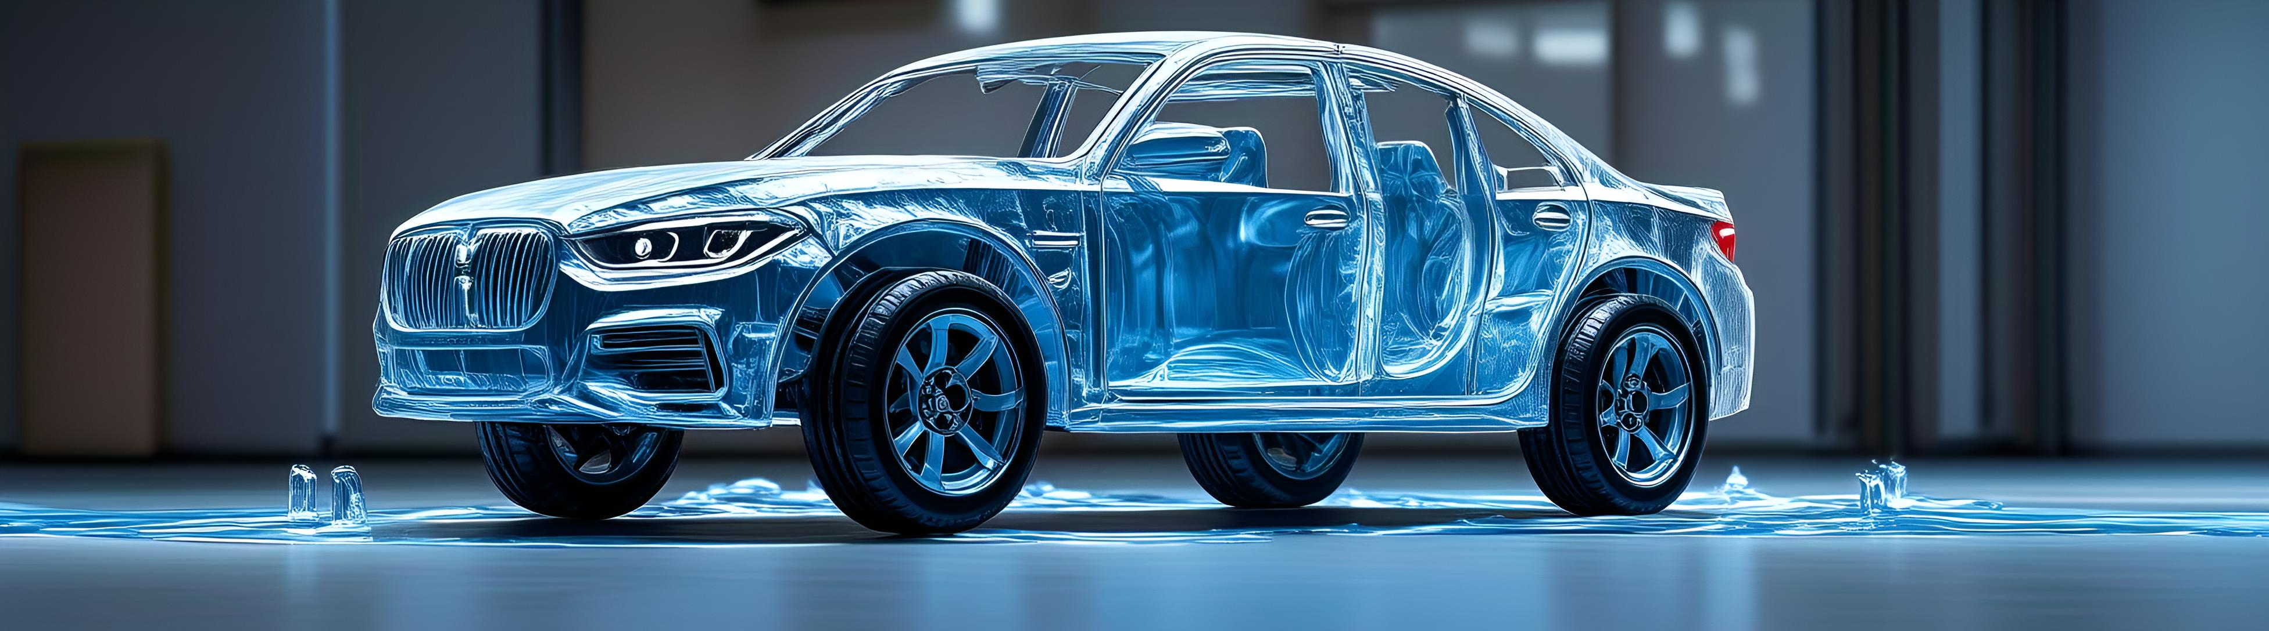
Core seals for Engine, Transmission, and Fuel System
Fuel System Applications
Engine System Applications
Transmission Applications
Fuel line O-rings, injector seals, fuel tank float seals
Turbocharger hoses, bellows, valve stem seals
Transmission seals, gaskets, and oil seals

Slide 23
Performance of Fluorosilicone Rubber in Automotive Oil-Contact Environments
Oil Type | Test Condition | Rate of volume change
Diesel | 80 ℃×336 h | 7~10%
Biodiesel(B20) | 80 ℃×336 h | 7~10%
RME (DIN14214) | 125 ℃×72 h | 8~10%
Engine oil（5W30） | 150 ℃×168 h | 2~3%
Brake Fluid（DOT3） | 120 ℃×72 h | 2~4%
Lubricating oil（206304） | 150 ℃×94 h | 2~3%
ASTM C | 23 ℃×72 h | 19~27%
FAM B | 23 ℃×72 h | 24~30%
IRM 903 | 150 ℃×72 h | 2~3%

Slide 24
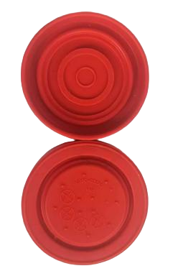
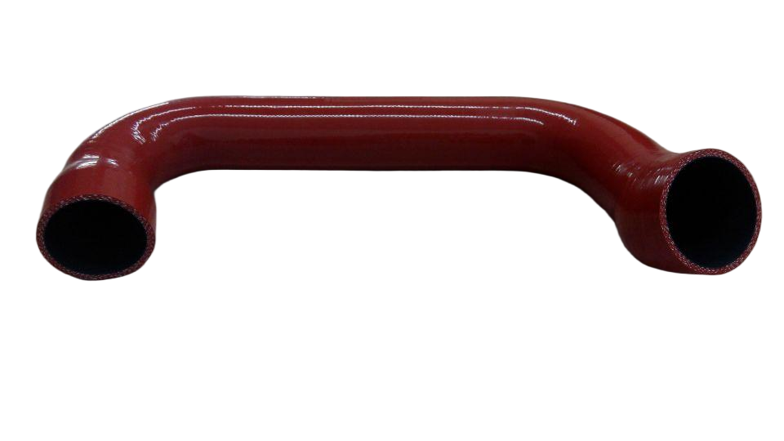
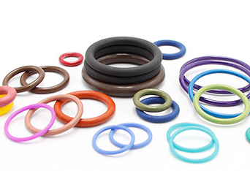
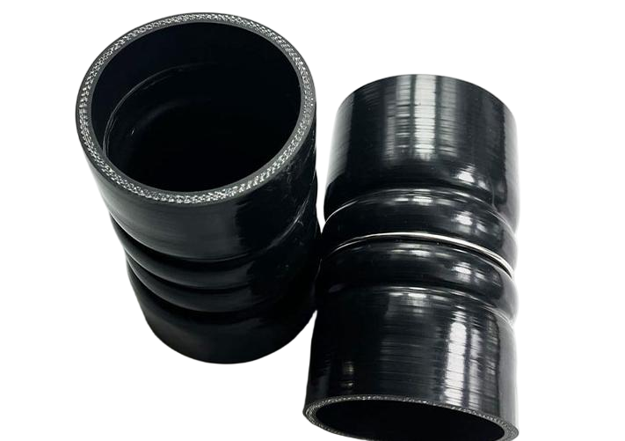
Automotive Applications
Exhaust Gas Valve
Turbocharger Hose
Bellows
Seals

Slide 25


Acid and Alkali Resistance
Solvent Resistance
Suitable for acid/alkali-resistant piping, unaffected by corrosive chemicals.
Used in valve seals, coating seals, and tank roof seals, offering excellent resistance to solvents.
Applications in Chemical and Power Industries
Weather Resistance
Transformer Oil Resistance
Ideal for outdoor cable sheathing, providing long-term oxidation resistance to ensure reliable power transmission.
Applied in transformer seals, with a dielectric loss of <0.5% in transformer oil.

Slide 26
Resistance to Solvents, Acids, and Alkalis of Fluorosilicone Rubber
Medium
Test Condition
Volume Swell /%
1
10 wt% HCl solution
23 ℃×168 h
+2
2
Concentrated HCl
23 ℃×168 h
+8
3
10 wt% HNO₃ solution
23 ℃×168 h
+1
4
10 wt% NaOH solution
23 ℃×168 h
+1
5
50 wt% NaOH solution
23 ℃×168 h
+2
详情
6
Ethanol
详情
23 ℃×168 h
+5
7
Xylene
23 ℃×168 h
+20
8
Carbon tetrachloride
23 ℃×168 h
+20

Slide 27
Sealing for Extreme Operating Conditions in Aerospace
Resistant to extreme temperatures
Resistance to Fuels and Chemicals
Resistance to Ozone and Nuclear Radiation
Operating range approximately –60 °C to +230 °C, with short‑term resistance above 250 °C.
Exhibits excellent resistance to jet fuels (JP‑4, JP‑8), solvents and other chemicals.
Resistant to ozone, UV & space radiation, suitable for external spacecraft components.
Applications include fuel tank seals, O-rings, refueling valve gaskets, and fuel lines.
Liquid Fluorosilicone Rubber (LSR) is also used as a surface coating, lubricant, sealant mastic, and adhesive.

Slide 28
Performance of Fluorosilicone Rubber in Aerospace Applications
Oil Type
Test Condition
Volume Change Rate/%
1
RP-3（Jet A-1）
65 ℃×24 h
+5
2
RP-3（Jet A-1）
175 ℃×72 h
+12
详情
3
AMS 2629
23 ℃ /22 h
+21
4
AMS 3021
150 ℃ /70 h
+12
详情
Performance
Test Condition
Test result
详情
Ozone resistance (aging)
200×10⁻⁸，40 ℃×72 h， 20%Tensile
No cracking
5

Slide 29

Smart Wearables
Fluorosilicone materials are key to enhancing the durability, safety, and premium feel of high‑end smartwatches and fitness trackers.
Watch Bands: All‑Day Comfort
Hypoallergenic and resistant to sweat, oils, alcohol, and cosmetics; easy to clean and disinfect.
Housing/Seals: Superior Water & Dust Resistance
Effectively protects internal electronics from moisture and dust, significantly extending product lifespan.
Medium | Test Condition | Volume Swell /%
Oleic acid | 23 ℃×24 h | ＜1%
Artificial sebum | 23 ℃×24 h | ＜1%
Artificial Sweat | 23 ℃×24 h | ＜1%

Slide 30
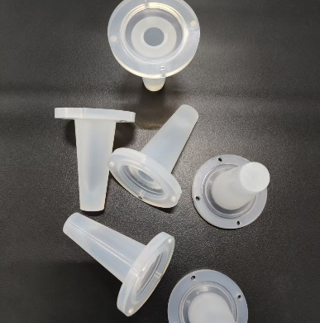
Applications in Cosmetics
Bottle Cap Seals and Gaskets
口红口红塑型软管
Lipstick molding tubes
Prevent leakage of essential oils and active ingredients; resistant to alcohols, glycerin, and other solvents.
Resistant to components in lipstick such as tree wax, mineral oil, and vegetable oil.
Essential oil | Test Condition | Volume Swell /%
Gardenia Essential Oil | 23 ℃×24 h | 7%
Eucalyptus essential oil | 23 ℃×24 h | 12%
Lipstick Molding Tube
（Addition-type liquid fluorosilicone rubber）

Slide 31
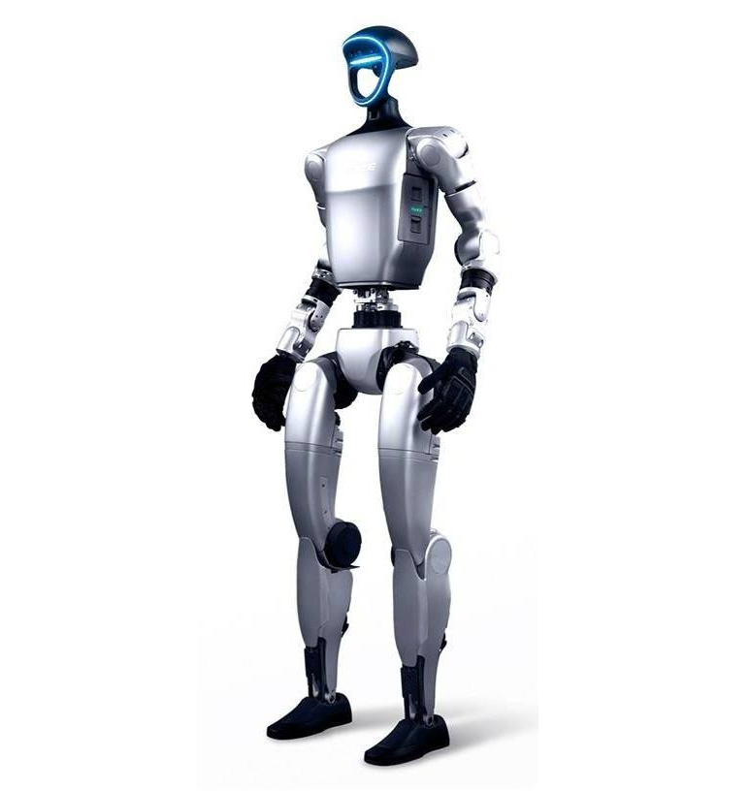



Broadening Application Areas
—— New-Generation Bionic Robots
Bionic skin：
Offers superior tactile sensing and biocompatibility while protecting internal precision components.
Special sealing：
High oil and heat resistance, suitable for demanding and complex working conditions.
Conductive fluorosilicone rubber：
Integrates EMI shielding and tactile sensing in a single, smart design.

Slide 32
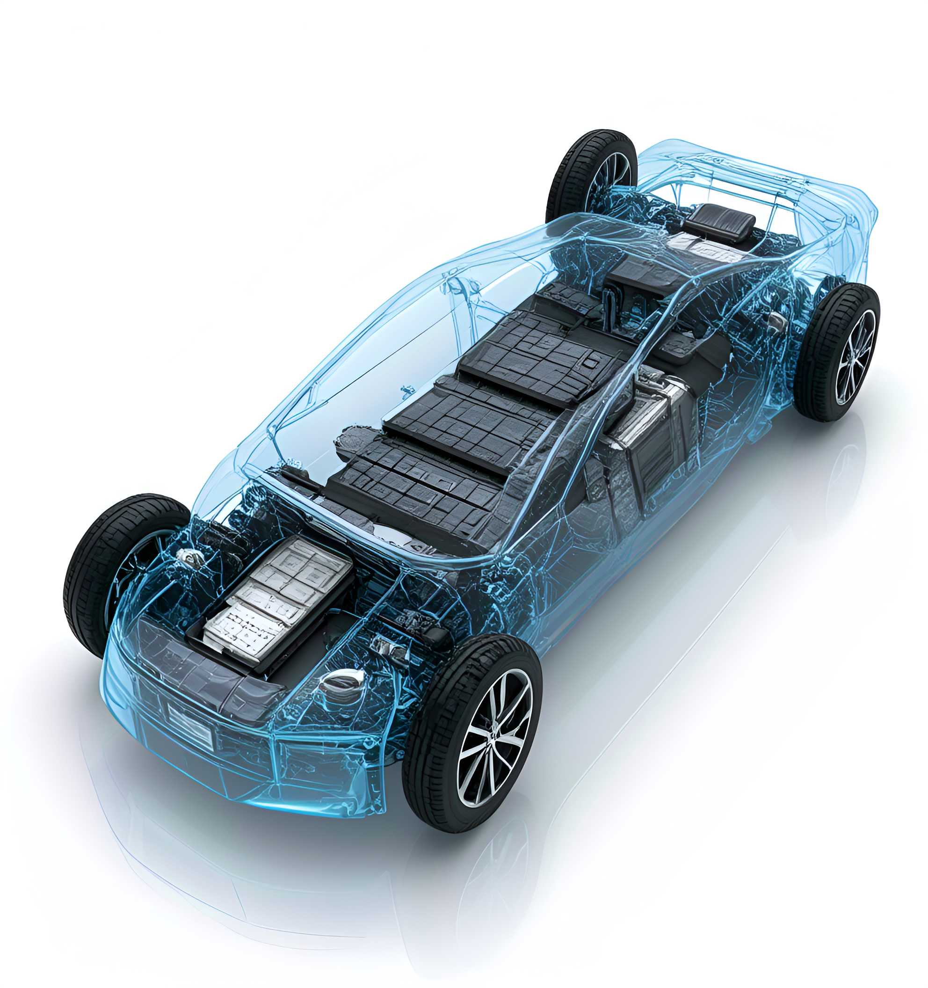


Broadening Application Areas
——New Energy
Outstanding Performance in New Energy Applications：
With high temperature and corrosion resistance, it serves as an ideal material for sealing and insulation in new energy batteries, significantly enhancing the safety and lifespan of battery packs.
Reliable Protection for Photovoltaic Modules:
Provides encapsulation and frame sealing, effectively resisting UV exposure and extreme weather conditions to ensure long-term stable operation of the modules.
Safety Assurance for Energy Storage Systems:
Offers excellent electrical insulation and chemical resistance, delivering efficient and reliable protection for energy storage systems.

Slide 33
Performance Comparison Between Fluorosilicone Rubber and Other Rubbers
Material | Advantage | Limitation
Fluorosilicone Rubber (FVMQ) | Excellent oil resistance across a wide temperature range; well‑balanced overall properties | Higher cost; lower tensile strength compared to fluororubber
Fluorocarbon Rubber (FKM) | Excellent oil resistance and high strength | Poor low-temperature performance (prone to embrittlement above –30 °C)
Silicone Rubber (VMQ) | High-temperature resistance (up to 300 ℃), good flexibility | Poor oil resistance, susceptible to swelling in oils
Acrylate Rubber（ACM） | Excellent oil resistance | Inferior low‑temperature performance

Slide 34
NEWERA
Thank you.
We welcome your inquiries!

